Slide 1
Multi-Robot Coordination Using a Market-based Approach
Gabe Reinstein and Austin Wang
6.834J
November 6, 2002

Slide 2
Outline
Why multiple robots?
Design requirements
Other approaches
The market-based approach
Example: Multi-robot exploration

Slide 3
Source Papers
Dias, M. B. and Stentz, A. 2001. A Market Approach to Multirobot Coordination. Technical Report, CMU-RI-TR-01-26, Robotics Institute, Carnegie Mellon University.
  Explains idea of market-based approach
Zlot, R. et al. 2002. Multi-Robot Exploration Controlled by a Market Economy. IEEE.
  Describes a particular implementation of this idea: mapping and exploration with multiple robots

Slide 4
Why Multiple Robots?
Some tasks require a team
  Robotic soccer
Some tasks can be decomposed and divided for efficiency
  Mapping a large area
Many specialists preferable to one generalist
Increase robustness with redundancy
Teams of robots allow for more varied and creative solutions

Slide 5
A Few Multi-robot Scenarios
Automated warehouse management
Planetary exploration and colonization
Automatic construction
Robotic cleanup of hazardous sites
Agriculture

Slide 6
Outline
Why multiple robots?
Design requirements
Other approaches
The market-based approach
Example: Multi-robot exploration

Slide 7
A Good Multi-robot System Is:
Robust: no single point of failure
Optimized, even under dynamic conditions
Quick to respond to changes
Able to deal with imperfect communication
Able to allocate limited resources
Heterogeneous and able to make use of different robot skills

Slide 8
Outline
Why multiple robots?
Design requirements
Other approaches
The market-based approach
Example: Multi-robot exploration

Slide 9
Basic Approaches
Centralized
  Attempting optimal plans
Distributed
  Every man for himself
Market-based

Slide 10
Centralized Approaches
Robot team treated as a single “system” with many degrees of freedom
A single robot or computer is the “leader”
Leader plans optimal actions for group
Group members send information to leader and carry out actions

Slide 11
Centralized Methods: Pros
Leader can take all relevant information into account
In theory, coordination can be perfect:
  Optimal plans possible!

Slide 12
Centralized Methods: Cons
Computationally hard
  Intractable for more than a few robots
Makes unrealistic assumptions:
  All relevant info can be transmitted to leader
  This info doesn’t change during plan construction
Result: response sluggish or inaccurate
Vulnerable to malfunction of leader
Heavy communication load

Slide 13
Distributed Approaches
Planning responsibility spread over team
Each robot basically independent
Robots use locally observable information to make their plans

Slide 14
Distributed Methods: Pros
Fast response to dynamic conditions
Little or no communication required
Little computation required
Smooth response to environmental changes
Very robust
  No single point of failure

Slide 15
Distributed Methods: Cons
Not all problems can be decomposed well
Plans based only on local information
Result: solutions are often highly sub-optimal

Slide 16
Outline
Why multiple robots?
Design requirements
Other approaches
The market-based approach
Example: Multi-robot exploration

Slide 17
Market-based Approach:
The Basic Idea
Based on the economic model of a free market
Each robot seeks to maximize individual “profit”
Robots can negotiate and bid for tasks
Individual profit helps the common good
Decisions are made locally but effects approach optimality
  Preserves advantages of distributed approach

Slide 18
Analogy To Real Economy
Robots must be self-interested
Sometimes robots cooperate, sometimes they compete
Individuals reap benefits of their good decisions, suffer consequences of bad ones
Just like a real market economy, the result is global efficiency

Slide 19
The Market Mechanism In Detail: Background
Consider:
  A team of robots assembled to perform a particular set of tasks
  Each robot is a self-interested agent
  The team of robots is an economy
  The goal is to complete the tasks while minimizing overall costs

Slide 20
How Do We Determine Profit?
Profit = Revenue – Cost
Team revenue is sum of individual revenues, and team cost is sum of individual costs
Costs and revenues set up per application
  Maximizing individual profits must move team towards globally optimal solution
Robots that produce well at low cost receive a larger share of the overall profit

Slide 21
Examples
Cost functions may be complex
  Based on distance traveled
  Based on time taken
  Some function of fuel expended, CPU cycles, etc.
Revenue based on completion of tasks
  Reaching a goal location
  Moving an object
  Etc.

Slide 22
Prices and Bidding
Robots can receive revenue from other robots in exchange for goods or services
  Example: haulage robot
If robots can produce more profit together than apart, they should deal with each other
  If one is good at finding objects and another is good at transporting them, they can both gain

Slide 23
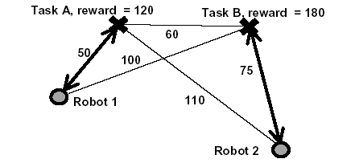
No Communication

Slide 24
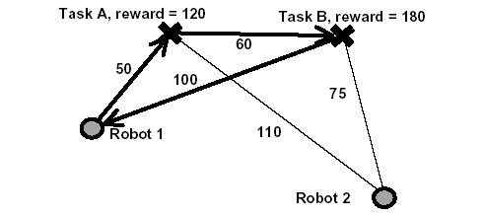
Subcontracting a Task
Notes:
Here, robot 2 subcontracts task B to save 150 in cost; robot 1 sees that the new route will add 110 in cost; so they negotiate a price of 130. Both robots profit, and the global task is accomplished at a lower cost. Note that robot 2 was a leader; all it did was generate and sell a plan.

Slide 25
How Are Prices Determined?
Bidding
  Robots negotiate until price is mutually beneficial
  Note: this moves global solution towards optimum
Robots can negotiate several deals at once
Deals can potentially be multi-party
Prices determined by supply and demand
  Example: If there are a lot of haulers, they won’t be able to command a high price
  This helps distribute robots among “occupations”

Slide 26
Competition vs. Coordination
Complementary robots will cooperate
  A grasper and a transporter could offer a combined “pick up and place” service
Similar robots will compete
  This drives prices down
This isn’t always true:
  Subgroups of robots could compete
  Similar robots could agree to segment the market
  Several grasping robots might coordinate to move a heavy objects

Slide 27
Leaders
A robot can offer its services as a leader
A leader investigates plans for other robots
If it finds a way for other robots to coordinate to maximize profit:
  Uses this profit to bid for the services of the robots
  Keeps some profit for itself
Note that this introduces a notion of centralization
  Difficult for more than a few robots

Slide 28
Why Is This Good?
Robust to changing conditions
  Not hierarchical
  If a robot breaks, tasks can be re-bid to others
Distributed nature allows for quick response
Only local communication necessary
Efficient resource utilization and role adoption
Advantages of distributed system with optimality approaching centralized system

Slide 29
Outline
Why multiple robots?
Design requirements
Other approaches
The market-based approach
Example: Multi-robot exploration

Slide 30
Multi-Robot Exploration
Goal: explore and map unknown environment
Environment may be hostile and uncertain
Communication may be difficult
Multiple robots:
  Cover more territory more quickly
  Robust if some robots fail
Attempt to minimize repeated coverage
Key: coordination
  Maximize information gain, reduce total costs

Slide 31
Previous Work
Balch and Arkin: communication unnecessary if robots leave physical trace behind
Latimer: can provably cover a region with minimal repeated coverage
  Very high communication requirement
  Fails if one robot fails
Simmons: frontier-based search with bidding
  Central agent greedily assigns tasks
  Suboptimal, centralized, high communication
Yamauchi: group frontier-based search
  Highly distributed: local maps and local frontier lists
  Coordination is limited, repeated coverage possible

Slide 32
Architecture of the Market Approach
World is represented as a grid
  Squares are unknown (0), occupied (+), or empty (-)
Goals are squares in the grid for a robot to explore
  Goal points to visit are the main commodity exchanged in market
For any goal square in the grid:
  Cost based on distance traveled to reach goal
  Revenue based on information gained by reaching goal
    R = (# of unknown cells near goal) x (weighting factor)
Team profit = sum of individual profits
  When individual robots maximize profit, the whole team gains

Slide 33
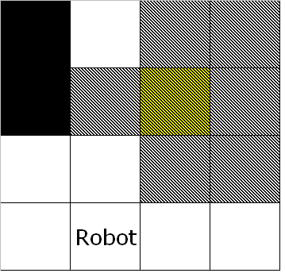
Example World

Slide 34
Exploration Algorithm
Algorithm for each robot:
Generate goals (based on goal selection strategy)
If OpExec (human operator) is reachable, check with OpExec to make sure goals are new to colony
Rank goals greedily based on expected profit
Try to auction off goals to each reachable robot
  If a bid is worth more than you would profit from reaching the goal yourself (plus a markup), sell it

Slide 35
Exploration Algorithm
Once all auctions are closed, explore highest-profit goal
Upon reaching goal, generate new goal points
  Maximum # of goal points is limited
Repeat this algorithm until map is complete

Slide 36
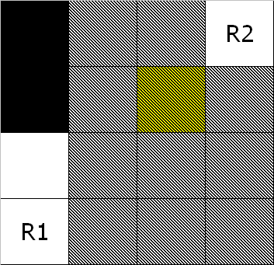
Bidding Example
R1 auctions goal to R2

Slide 37
Expected vs. Real
Robots make decisions based on expected profit
  Expected cost and revenue based on current map
Actual profit may be different
  Unforeseen obstacles may increase cost
Once real costs exceed expected costs by some margin, abandon goal
  Don’t get stuck trying for unreachable goals

Slide 38
Goal Selection Strategies
Possible strategies:
  Randomly select points, discard if already visited
  Greedy exploration:
    Choose goal point in closest unexplored region
  Space division by quadtree

Slide 39
Benefit of Prices
Low-bandwidth mechanisms for communicating aggregate information
Unlike other systems, map info doesn’t need to be communicated repeatedly for coordination

Slide 40
Information Sharing
If an auctioneer tries to auction a goal point already covered by a bidder:
  Bidder tells auctioneer to update map
  Removes goal point
Robots can sell map information to each other
  Price negotiated based on information gained
  Reduces overlapping exploration
When needed, OpExec sends a map request to all reachable robots
  Robots respond by sending current maps
  OpExec combines the maps by adding up cell values

Slide 41
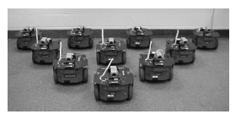
Experimental Setup
4 or 5 robots
  Equipped with fiber optic gyroscopes
  16 ultrasonic sensors

Slide 42
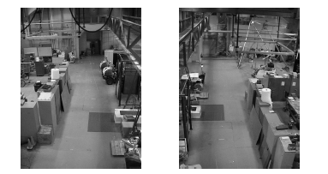
Experimental Setup
Three test environments
  Large room cluttered with obstacles
  Outdoor patio, with open areas as well as walls and tables
  Large conference room with tables and 100 people wandering around
Took between 5 and 10 minutes to map areas

Slide 43
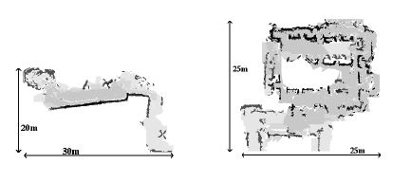
Experimental Results

Slide 44
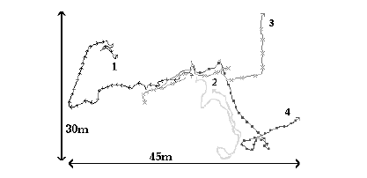
Experimental Results

Slide 45
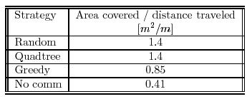
Experimental Results
Successfully mapped regions
Performance metric (exploration efficiency):
  Area covered / distance traveled [m² / m]
  Market architecture improved efficiency over no communication by a factor of 3.4

Slide 46
Conclusion
Market-based approach for multi-robot coordination is promising
  Robustness and quickness of distributed system
  Approaches optimality of centralized system
  Low communication requirements
Probably not perfect
  Cost heuristics can be inaccurate
  Much of this approach is still speculative
    Some pieces, such as leaders, may be too hard to do

